Slide 1

Event Management System
Presented by:
Ambreen Naeem
Sameea Majeed
Sadaf Fatima

Slide 2

Introduction:
Event management involves planning, organizing, and executing events.
Manual event handling is inefficient
and error-prone.
Zentro is a web-based application that automates:
Event creation
User registration
Ticket booking
Data storage and management

Slide 3

Problem Statement:
Current event management systems are often hampered by labour-intensive manual processes. Without automation, critical functions become cumbersome and inefficient:
Registration Tracking
Manually overseeing attendee registrations becomes a complex task as numbers grow.
Payment Handling
Managing varied payment methods and ensuring accurate financial records is challenging.
Ticket Distribution
The manual distribution and validation of tickets present logistical nightmares for large-scale events.

Slide 4





Core Objectives:
The primary goal of our Event Management System is to provide a comprehensive, user-friendly platform that simplifies every aspect of event organization and participation.
Online Event Creation
User Registration & Booking
Empower organizers to easily create, publish, and manage event details, including schedules, venues, and descriptions.
Enable attendees to register for events, select ticket types, and complete bookings seamlessly through an intuitive interface.
Admin Control & Monitoring
Secure Database Storage
Provide administrators with powerful tools to oversee all events, manage users, and monitor system activities effectively.
Ensure all event, user, and transaction data is stored securely and reliably in a robust database.

Slide 5



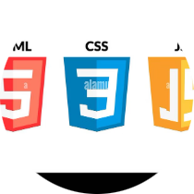
Technologies Utilized: Building Blocks of Innovation
Visual Studio
SQL Server Management Studio
An intelligent IDE used for efficient coding, debugging, and project management in Django development.
The integrated environment for managing SQL Server infrastructure, used for database design and administration.
Database
Backend
SQL (Using SSMS)
Django
Frontend
HTML
CSS JavaScript

Slide 6
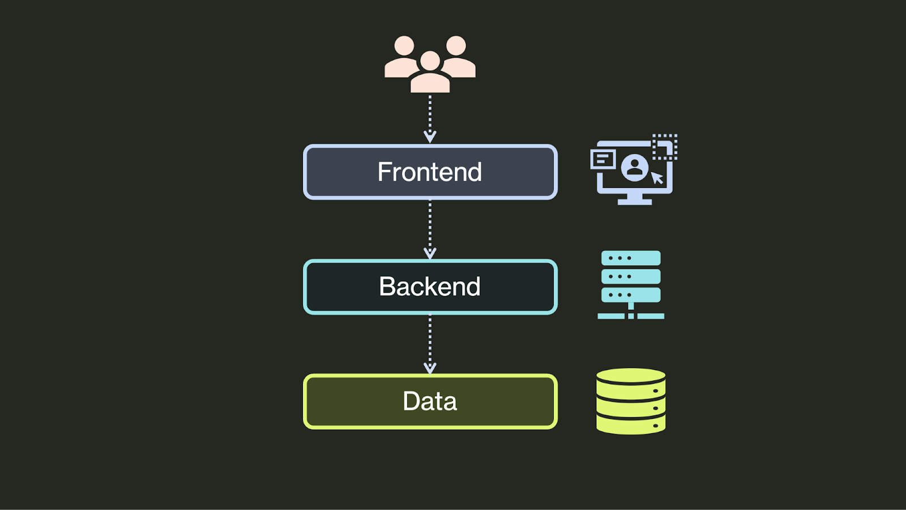

System Architecture: A Three-Tiered Approach
Our Event Management System employs a classic three-tier architecture, ensuring clear separation of concerns, scalability, and maintainability. This structure facilitates efficient data flow and robust application performance.
SQL Server
Persistent relational
data store
Django Backend
Business logic and
API layer
User Interface
Client-facing web
This architecture provides a clear pathway for user requests, processing logic, and data storage, creating a stable and scalable foundation for the application.

Slide 7

Database Design:
Database contains the following tables:
User
Event
Attendee
Ticket
Registration
All tables are connected using Primary and Foreign Keys.

Slide 8
Database Design: The Backbone of Information
The database schema is meticulously designed to ensure data integrity, efficient retrieval, and robust relationships between different entities. This forms the foundational structure for all event-related information.
Event Table
Ticket Table
Stores details about each event, including name, date, location, description, and capacity.
Defines different ticket types for events, including price, availability, and specific features.
Attendee Table
Registration Table
Contains user information, such as name, contact details, and account credentials.
Links attendees to events and tickets, recording registration status, payment, and unique identifiers.

Slide 9
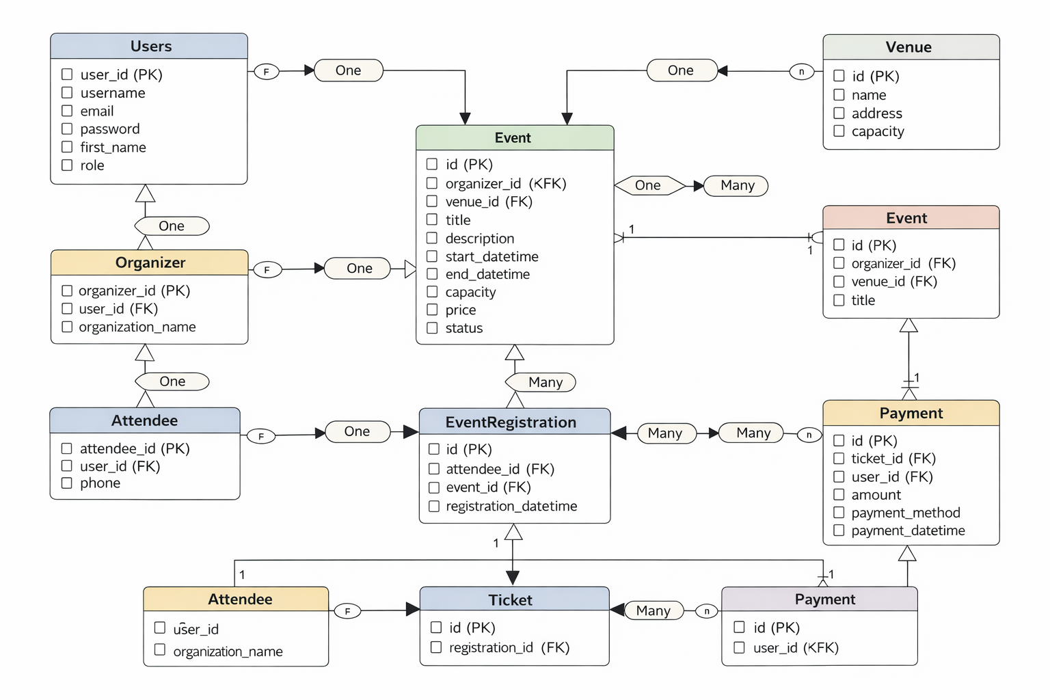
Database Relationships:
One event can have many registrations
One user can register for multiple events
Foreign keys ensure referential integrity

Slide 10

System Users:
Admin – manages the system (SuperUser)
Organizer – creates and manages events
Attendee – registers, books tickets, and makes payments

Slide 11

Workflow
User registers/login
Organizer creates event
Attendee books ticket
Payment processed
Ticket generated

Slide 12
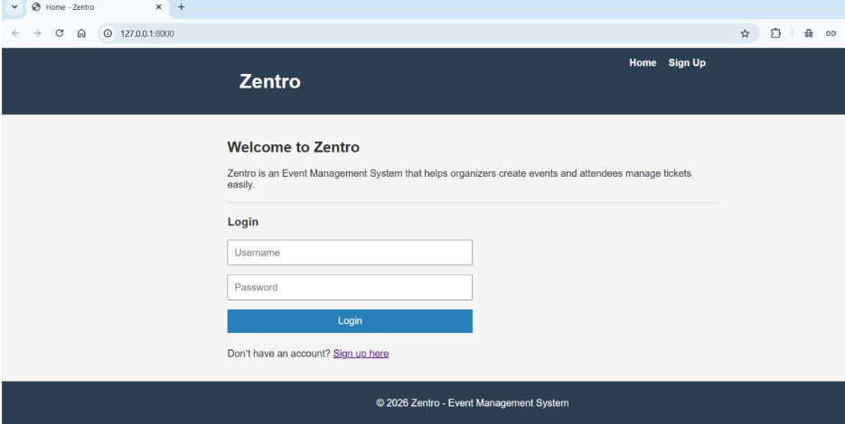
Key Features:
Our Event Management System offers a comprehensive suite of features designed to cater to both event attendees and organizers, ensuring a smooth and efficient experience for all.
1
User Authentication
Secure login and registration processes, allowing
users to create accounts and manage their profiles
with ease.
2
Event Creation & Editing
Organizers can effortlessly create new events,
update details, and manage event lifecycles through
an intuitive interface.
3
Event Registration
A streamlined registration flow for attendees to
sign up for events, select ticket options, and
provide necessary information.

Slide 13
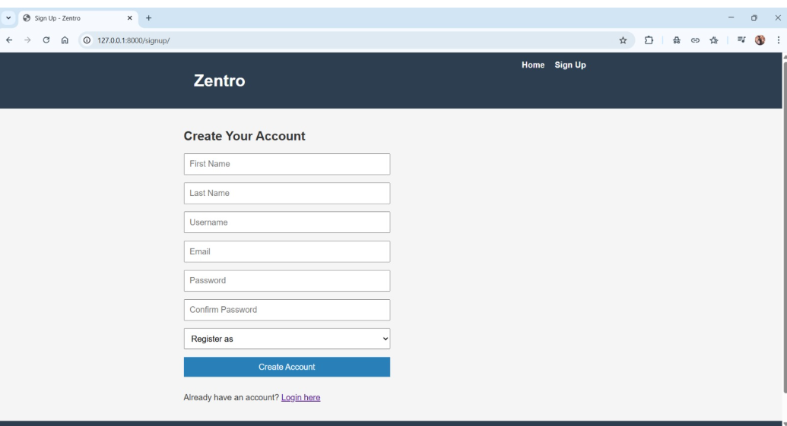
Zentro Signup:
.

Slide 14
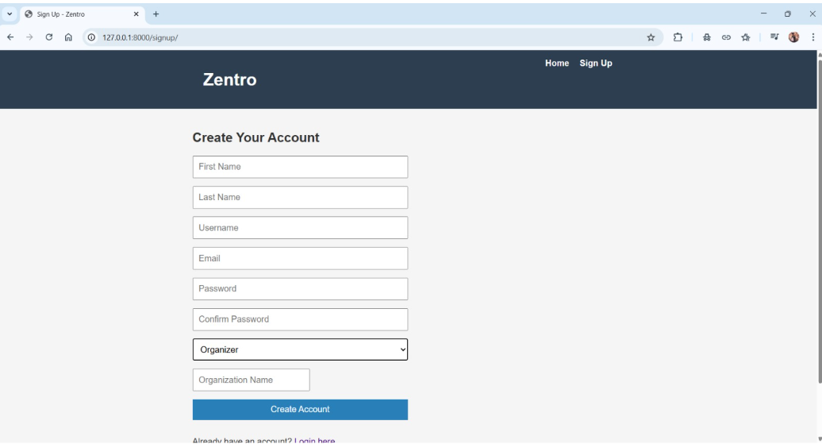
Signup(As an Organizer):

Slide 15
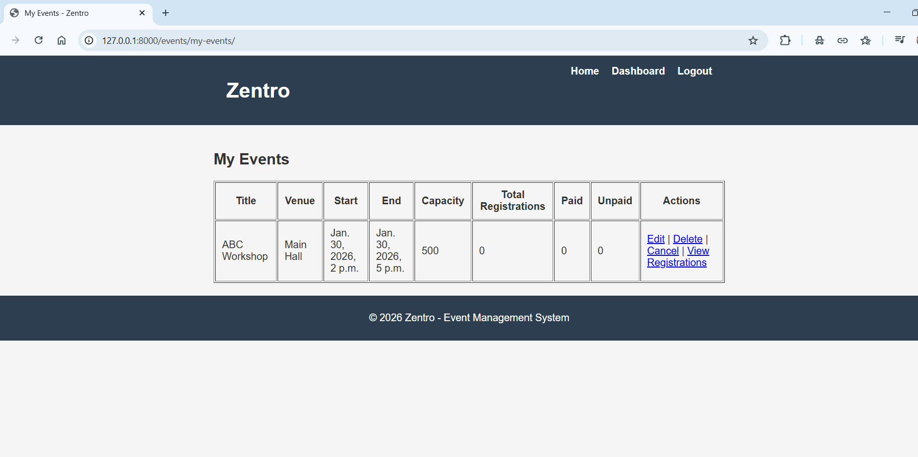
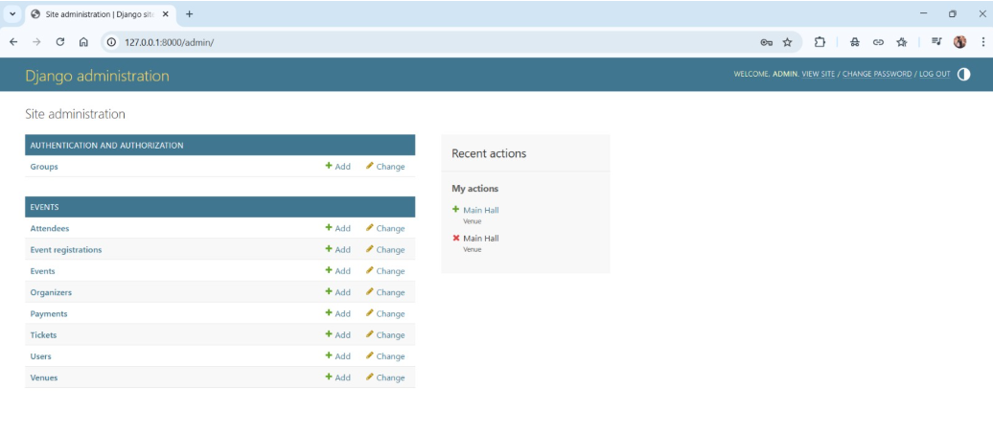
Key Features (contd.):
4
Ticket Payment Tracking
Integrated mechanisms to track payment statuses,
manage transactions, and ensure accurate
financial record-keeping.
5
Admin Dashboard
A centralized control panel for administrators
to oversee all system activities, manage users,
and gain insights into event performance.

Slide 16

Future Enhancements:
Online payment integration
Email and SMS notifications
Mobile application
Upgraded Design
Improved Securtity
Advanced analytics dashboard

Slide 17

Conclusion:
The Event Management System successfully automates event handling.
It demonstrates effective use of DBMS concepts and web technologies.

Slide 18
Thank You

